Slide 1
Using the SiSaNA Pipeline to Reconstruct and Analyze Patient-Specific Gene Regulatory Networks
Nolan Newman and ine bonthuis
Obiwow 2025
December 11th, 2025

Slide 2
Schedule
45 mins – Introduce SiSaNA/PANDA/LIONESS and discuss learning objectives
30 mins – Break/Help getting SiSaNA installed for everyone
1 hour – Run the SiSaNA pipeline and conduct a mini-analysis
30 mins – Discuss the results of your analysis and the worksheet given

Slide 3
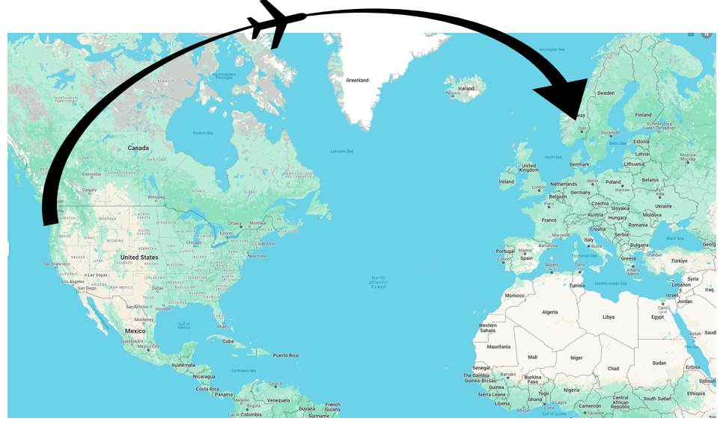

About me
PhD at Oregon State University
Computational biology
Microbiology
Pharmacology
Systems biology
Main research topic: Using computational biology and networks to identifying specific genes and microbes that influence disease
Now work in the Kuijjer lab and study gene regulation in breast cancer

Slide 4
Quick disclaimer
This lecture is designed to introduce you to the PANDA and LIONESS algorithms and how to create networks from them using the SiSaNA pipeline.
This software is still in beta testing and you all will be my beta testers, so apologies if there are any issues!
We will be using a very small number of samples in this workshop to ensure we have time to finish it. But one would need many more samples for an actual experiment!

Slide 5
Transcriptional regulation
Regulatory networks model gene regulation, which occurs at multiple levels
Epigenetic level
Methylation
Post-transcriptional modification
Alternative splicing
Transcriptional level
Transcription factors

Slide 6
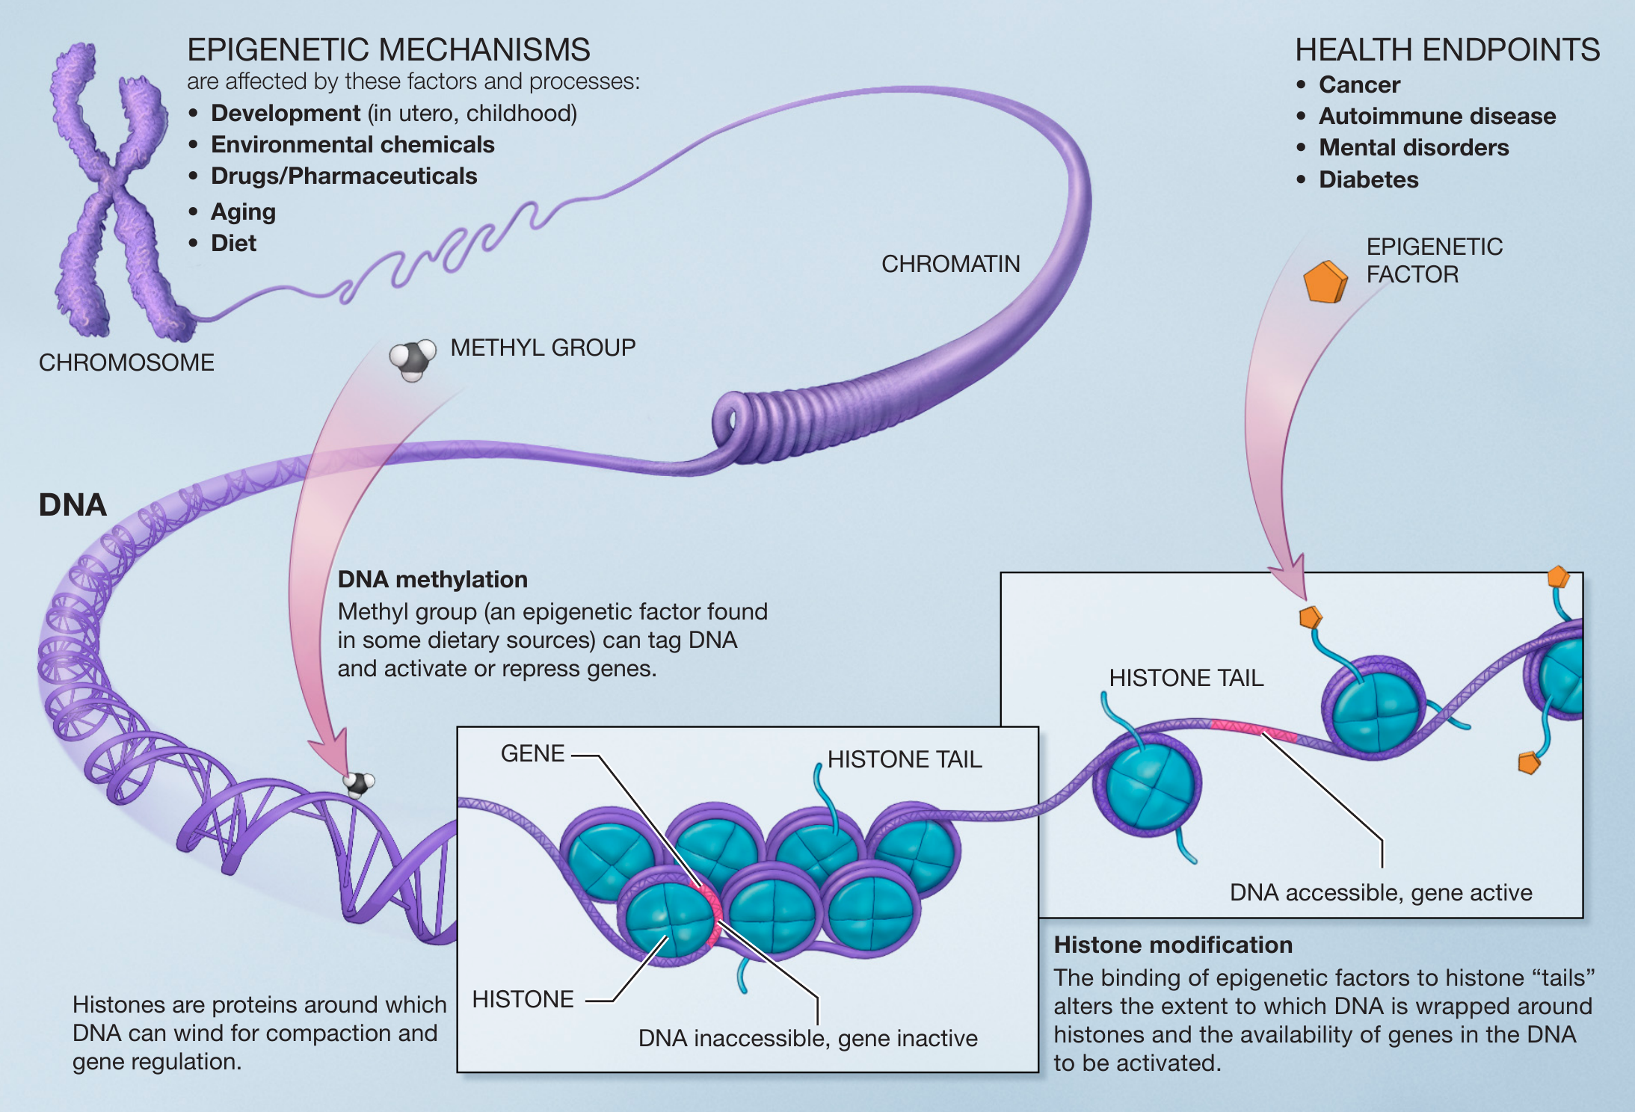
Epigenetic regulation
https://upload.wikimedia.org/wikipedia/commons/f/fc/Epigenetic_mechanisms.png

Slide 7
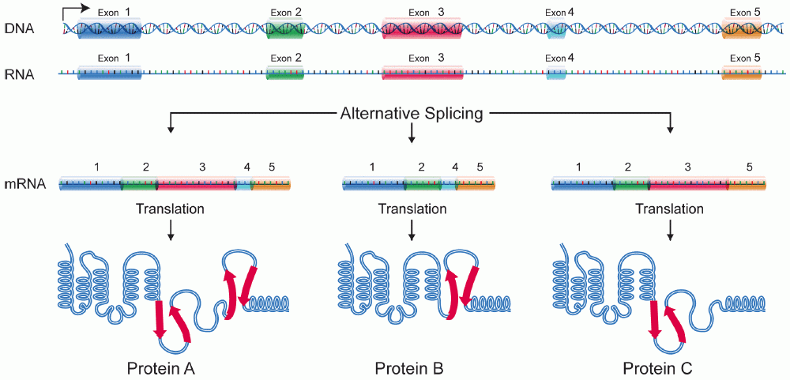
Post-transcriptional modification
https://upload.wikimedia.org/wikipedia/commons/0/0a/DNA_alternative_splicing.gif

Slide 8
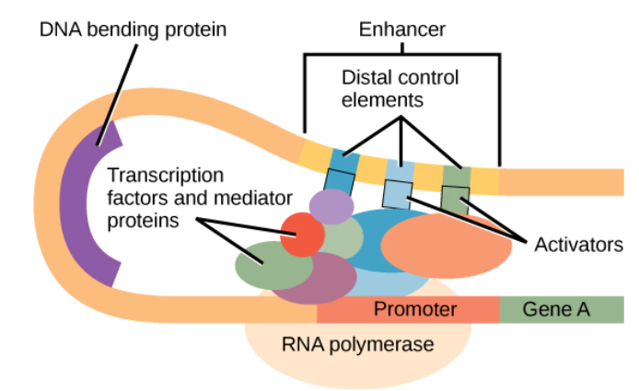
Regulation via transcription factors
https://courses.lumenlearning.com/wm-biology1/chapter/reading-eukaryotic-transcription-gene-regulation/

Slide 9
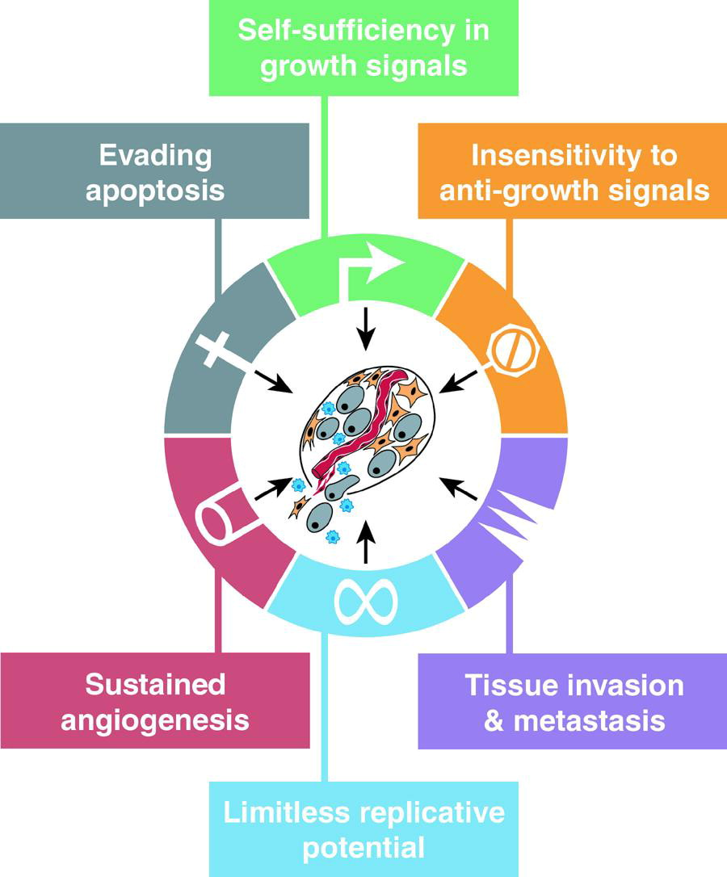
the regulation of cancer
Cancer is an incredibly difficult disease to study
In 2000, Hanahan and Weinberg publish their famous paper “The Hallmarks of Cancer”
Lays out the required characteristics for a tumor to be considered cancerous
Hanahan & Weinberg, 2000
https://www.cell.com/cell/fulltext/S0092-8674(00)81683-9

Slide 10
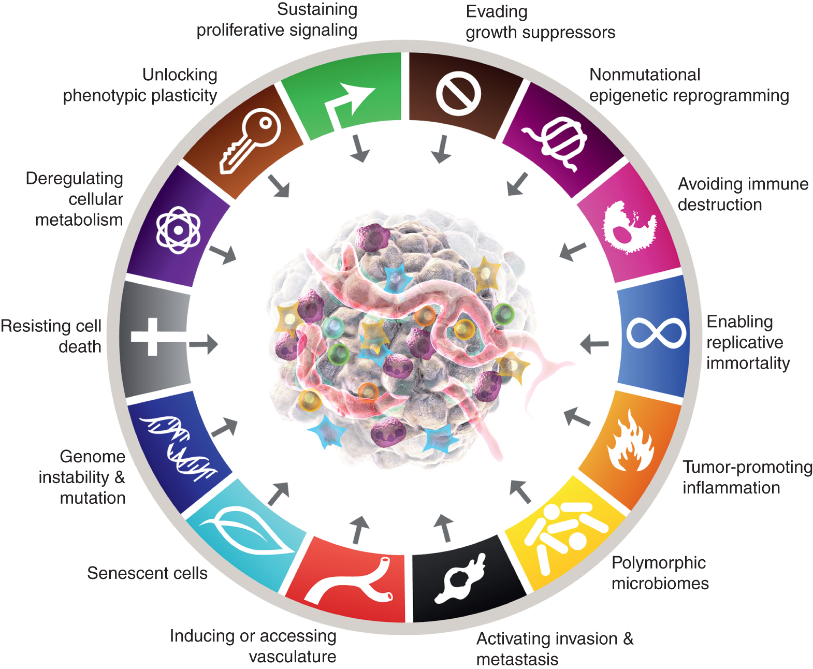
Applying these tools to understand the regulation of cancer
They later expanded this model
A key factor for ALL of these is transcriptional regulation!
Hanahan & Weinberg, 2011
https://aacrjournals.org/cancerdiscovery/article/12/1/31/675608/Hallmarks-of-Cancer-New-DimensionsHallmarks-of

Slide 11

The network zoo
An ecosystem of network reconstruction and analysis tools
PANDA – models TF-gene regulatory interactions for a group of samples
LIONESS – models TF-gene regulatory interactions for a single sample
PUMA – models gene regulation via microRNA
PORCUPINE – identifies pathways that display heterogeneous gene regulation across a patient population
SCORPION – models regulatory networks on single-cell data
…and more!
https://www.kuijjerlab.org/tools/

Slide 12
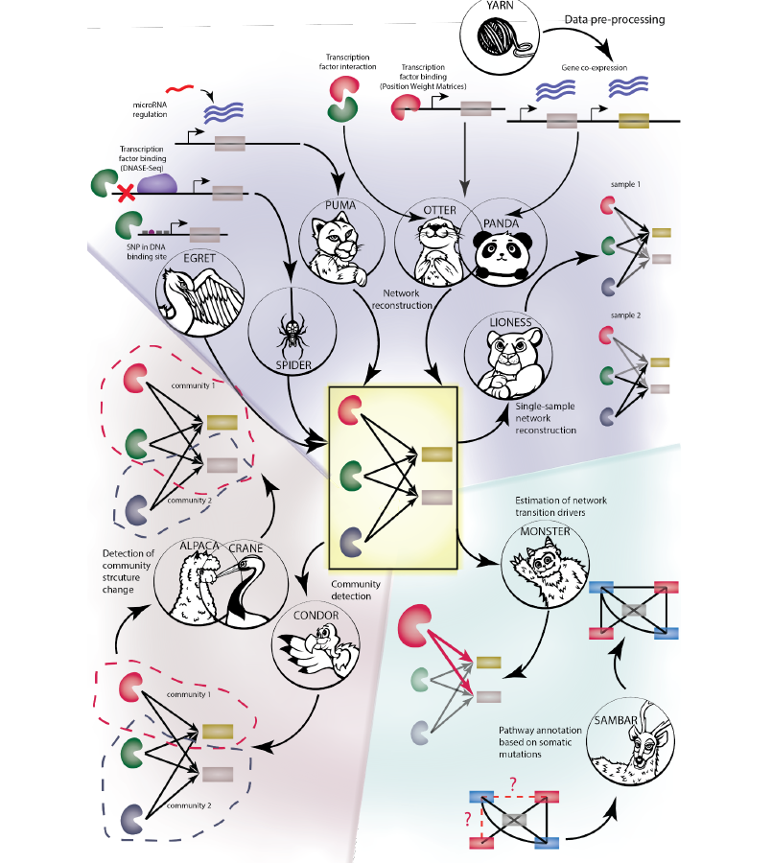
The network zoo
An ecosystem of network reconstruction and analysis tools
PANDA – models TF-gene regulatory interactions for a group of samples
LIONESS – models TF-gene regulatory interactions for a single sample
PUMA – models gene regulation via microRNA
PORCUPINE – identifies pathways that display heterogeneous gene regulation across a patient population
SCORPION – models regulatory networks on single-cell data
…and more!
https://genomebiology.biomedcentral.com/articles/10.1186/s13059-023-02877-1

Slide 13
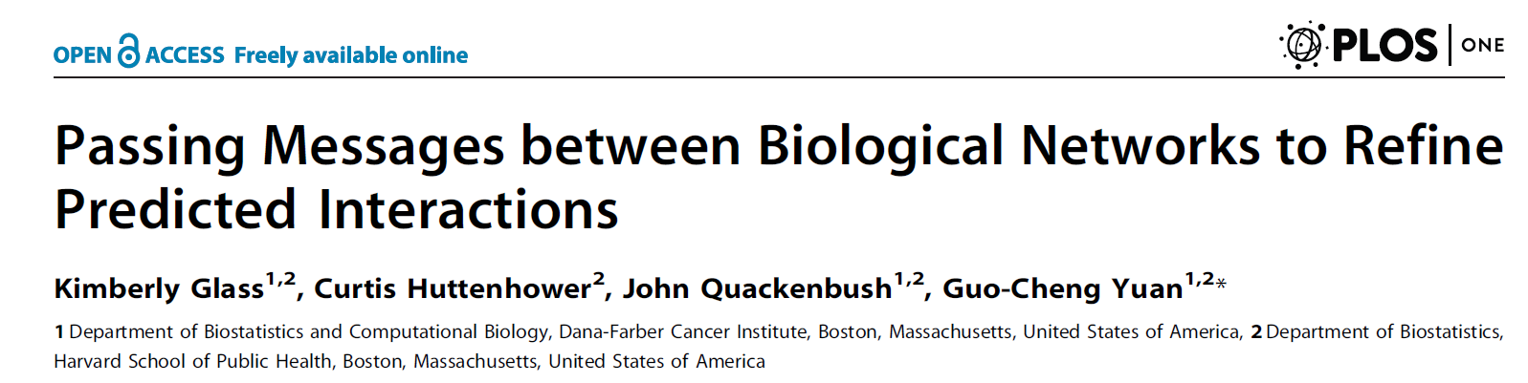
Panda models regulatory interactions
PANDA: Passing Attributes between Networks for Data Assimilation
Glass et al., 2013

Slide 14
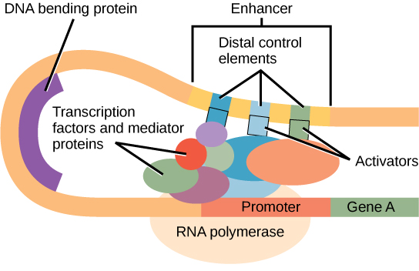
Panda models regulatory interactions
TFs
genes
High out-degree
High in-degree
How “strongly” each TF regulates each gene
https://courses.lumenlearning.com/wm-biology1/chapter/reading-eukaryotic-transcription-gene-regulation/

Slide 15
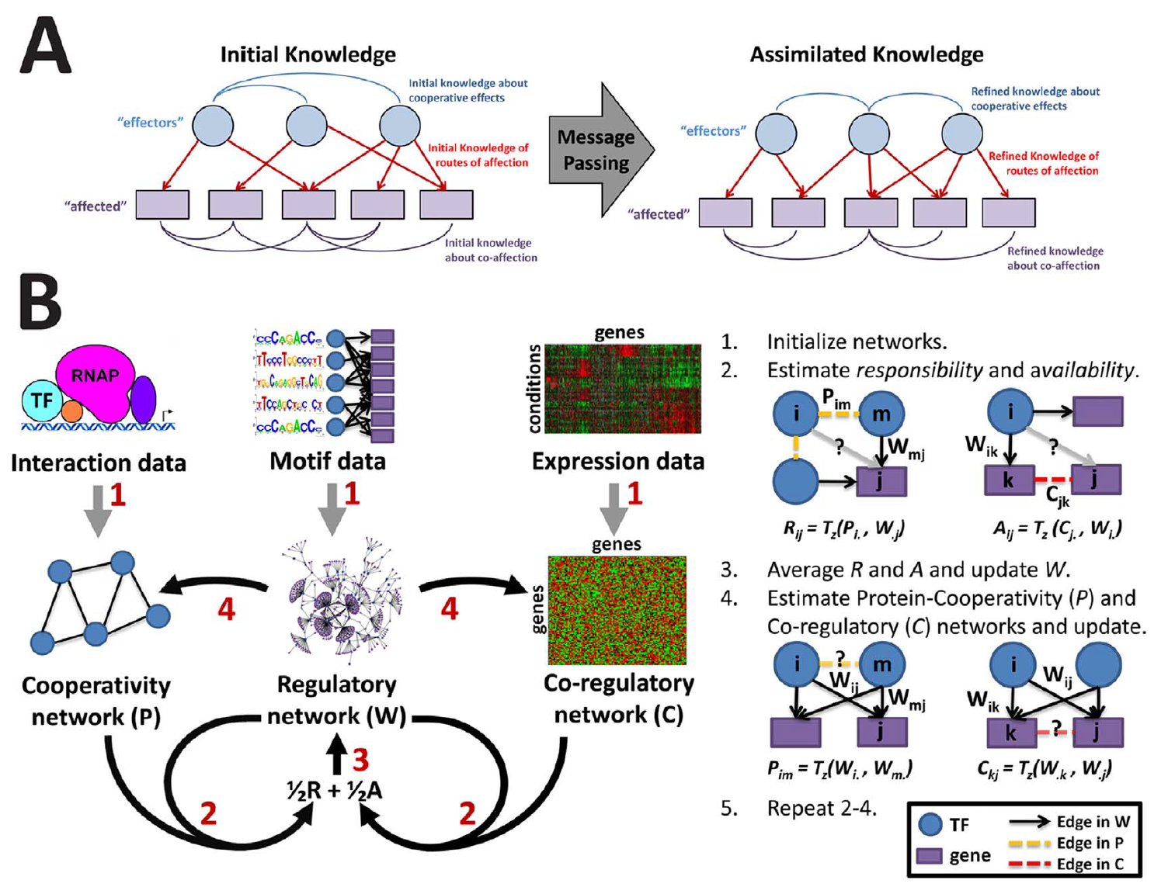
Panda uses a message passing approach to achieve this
Glass et al., 2013

Slide 16
Panda uses a message passing approach to achieve this
Glass et al., 2013

Slide 17
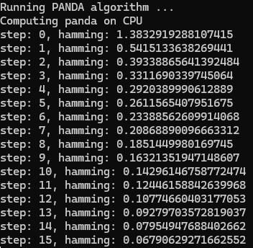
The hamming distance
As PANDA runs, it will display a “hamming” value
This value tells you how similar each successive network is to the previously made network
We can set a threshold for the hamming value to determine when the PANDA algorithm will finish running

Slide 18
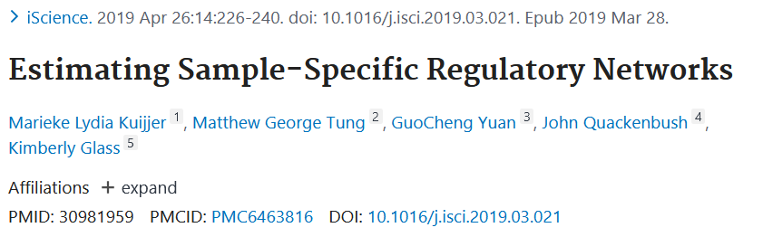
lioness
Similar to PANDA, but it can model transcriptional regulation for individual samples
Lioness: Linear Interpolation to Obtain Network Estimates for Single Samples
Kuijjer et al., 2018

Slide 19
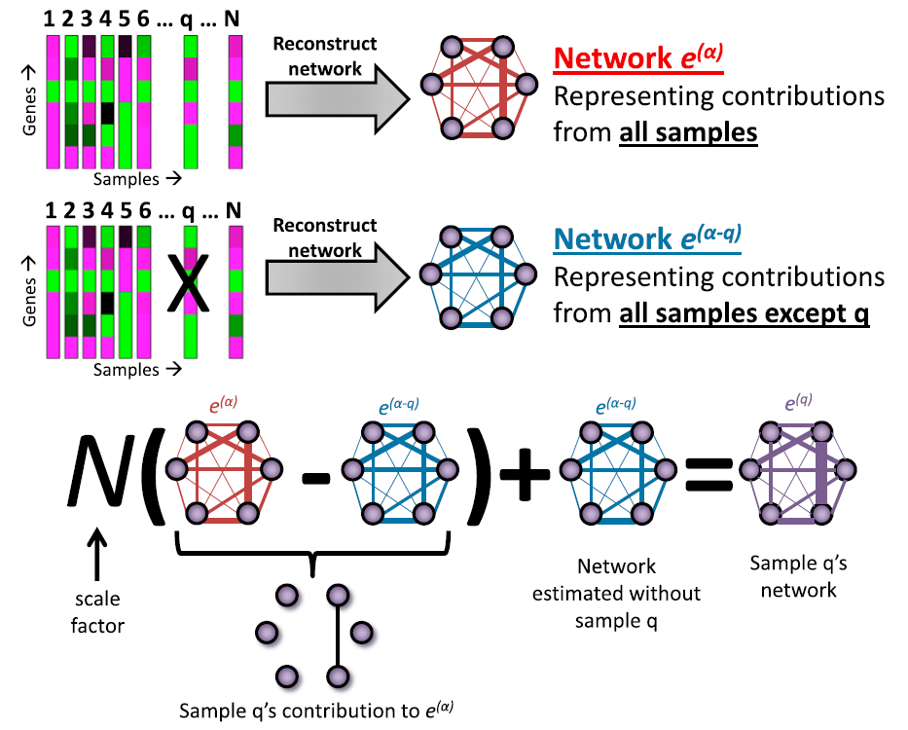
lioness
Uses the PANDA algorithm in its network reconstruction
Repeatedly uses the PANDA algorithm to make networks without a sample of interest
Then compares the network without the sample to the network that included that sample and scales the difference
Kuijjer et al., 2018

Slide 20
Applying lioness to breast cancer data
A quick overview of breast cancer…
Most commonly diagnosed cancer worldwide (according to NIH)
Every 14 seconds somewhere in the world is diagnosed with breast cancer
Very heterogeneous disease due to molecular differences between patients

Slide 21
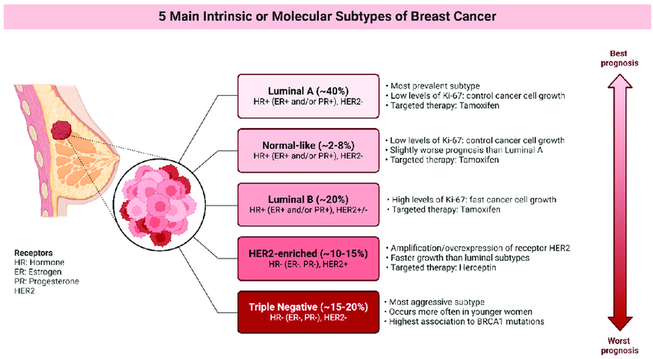
Al-Ruwishan et al., 2024

Slide 22
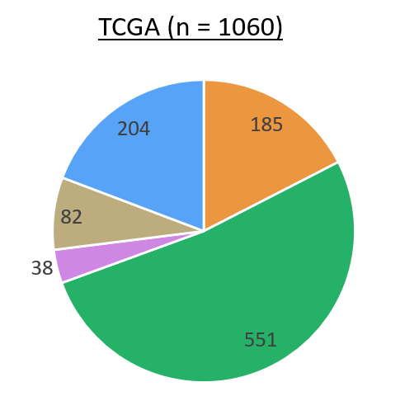





Online databases such as TCGA and Metabric can be used as sources of biological data for breast cancer
PAM50: A set of 50 genes used to stratify patients into different subtypes of breast cancer
Subtypes differ greatly in disease-free survival, response to treatment, and molecular classification of disease

Slide 23
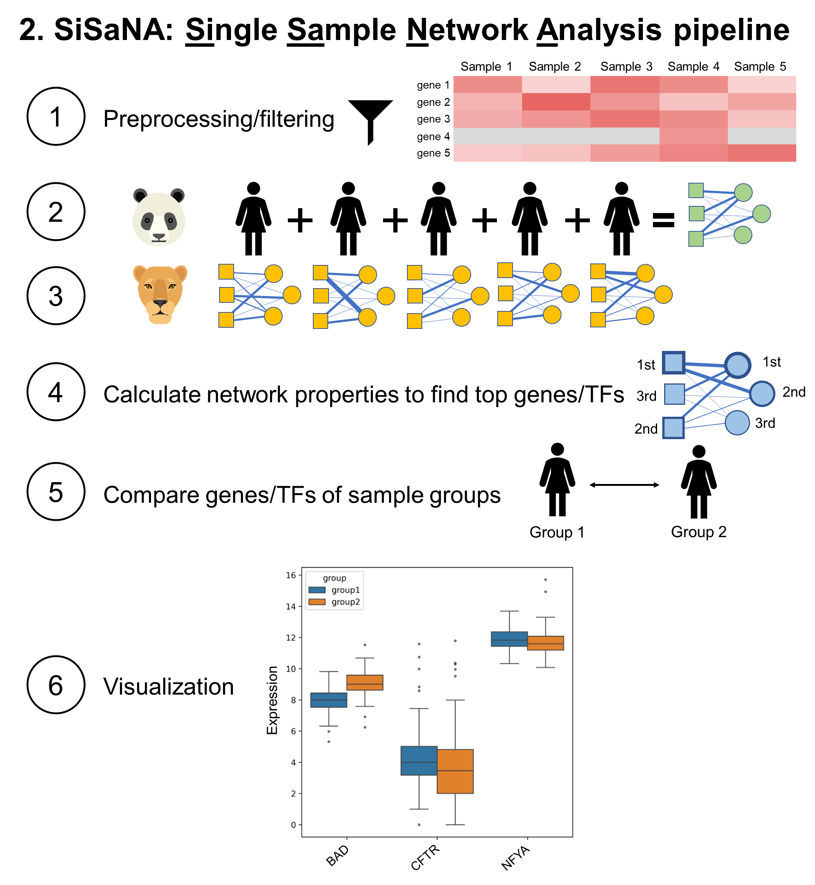
Using sisana to create and analyze patient specific regulatory networks
Note: This and the following slides contain unpublished work. Please do not distribute.
SiSaNA is a command line interface (CLI) that acts as a wrapper for PANDA and LIONESS
No programming expertise needed!
Allows the user to reconstruct these networks, as well as easily perform downstream analysis and visualization of their results

Slide 24
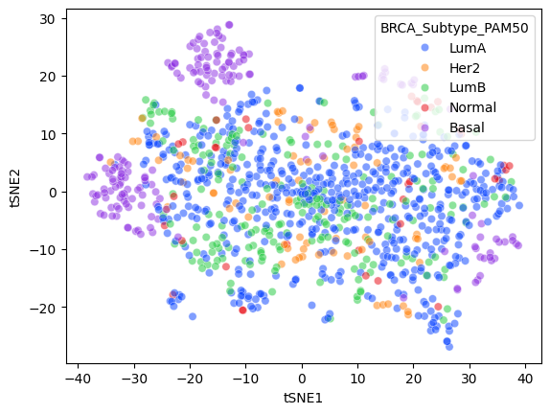
Clustering of breast cancer on in-degrees reveals two distinct basal clusters

Slide 25
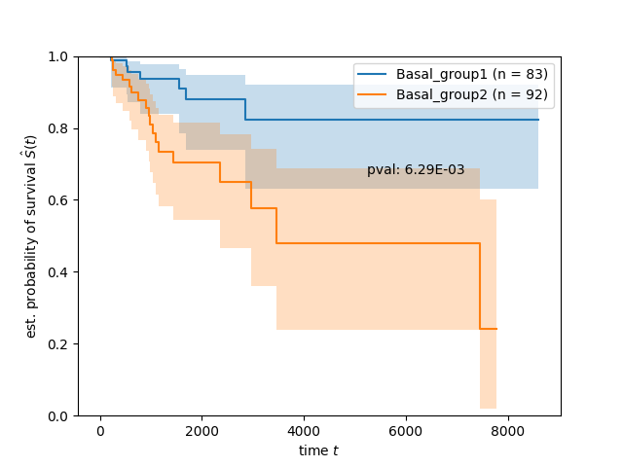
These two basal groups greatly differ in survival

Slide 26
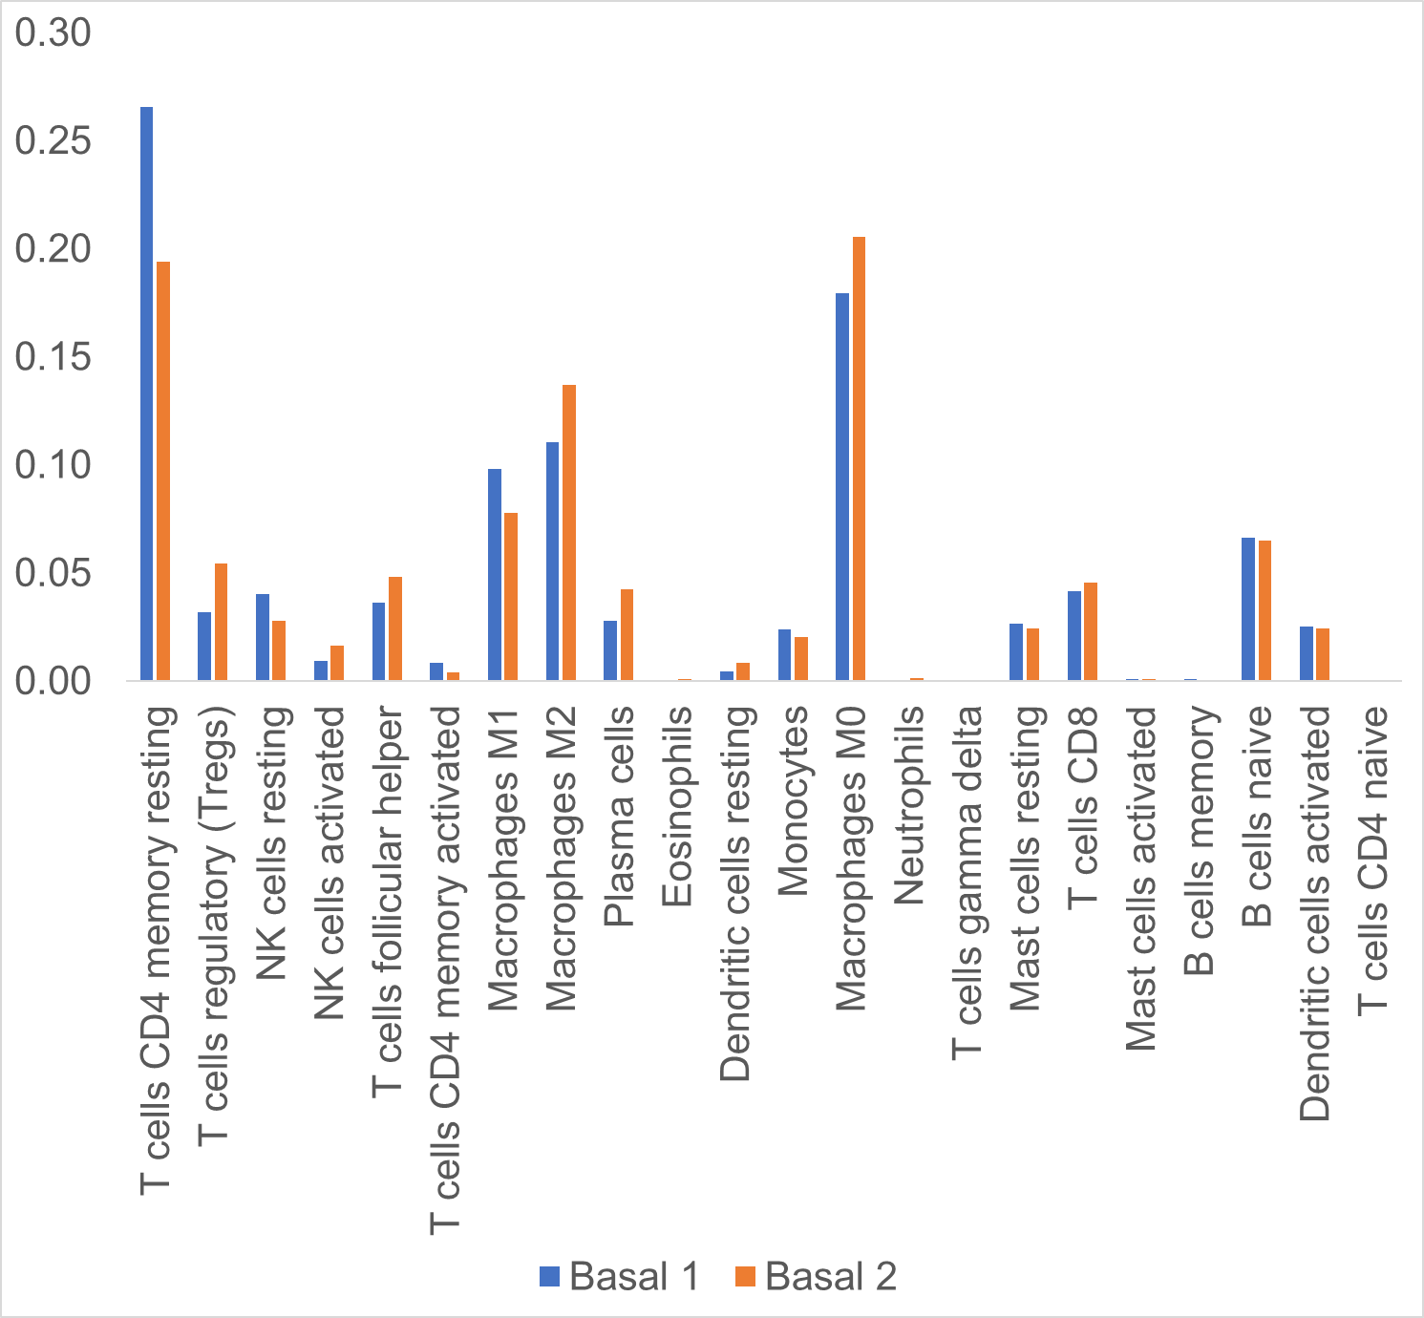

T cell, NK cells, and Macrophages distinguish the two basal groups from one another

Slide 27
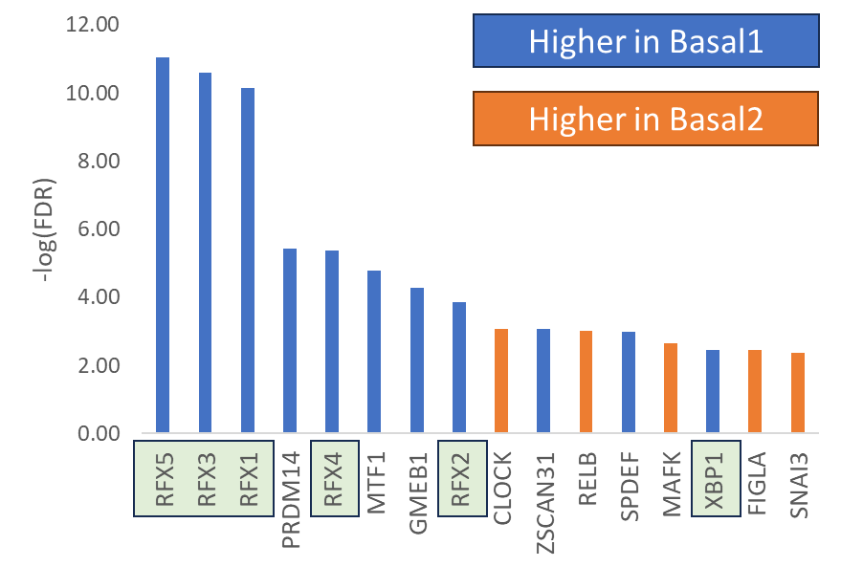
The RFX family of transcription factors specifically appear to play a large role in the transcriptional landscape that separates the basal groups
RFX proteins
MHC class II regulatory factors (increases MHC class II gene expression)
Broadly recognized to be associated with various cancer types
Regulate genes through the x-box sequence motif
ESR1 promotes expression of RFX1-3,5,7 and ESR1 is also expressed higher in Basal1
Transcription factor

Slide 28
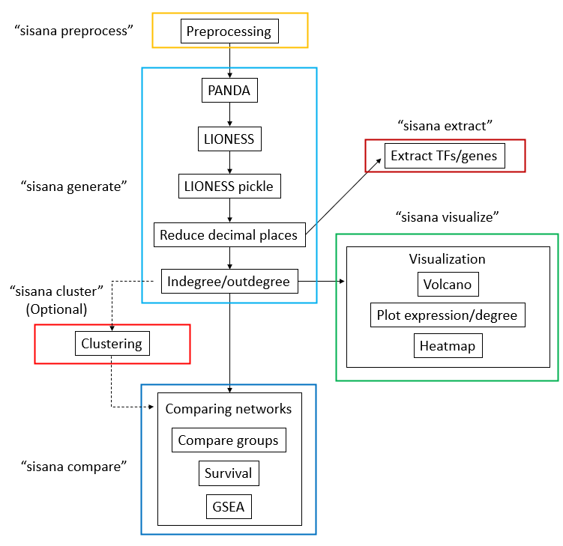
Your task for today
We will be performing a similar analysis to the one I just demonstrated
Use the SiSaNA pipeline to reconstruct and compare patient-specific LumA (n = 10) and LumB (n = 10) networks from breast cancer patients in the TCGA database

Slide 29
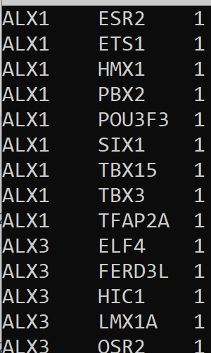
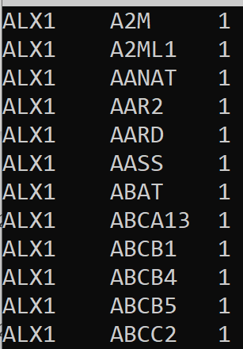
Sisana input files
PPI
Known
interaction?
TF-motif
Known
binding?
TF
Motif
3 files:
Protein-protein interaction
TF-motif file
Gene expression data
TF
TF

Slide 30
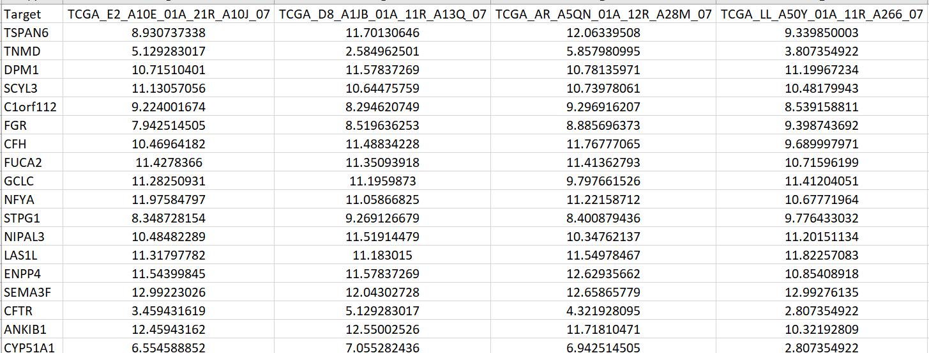
Sisana input files
Samples
3 files:
Protein-protein interaction
TF-motif file
Gene expression data
Genes

Slide 31
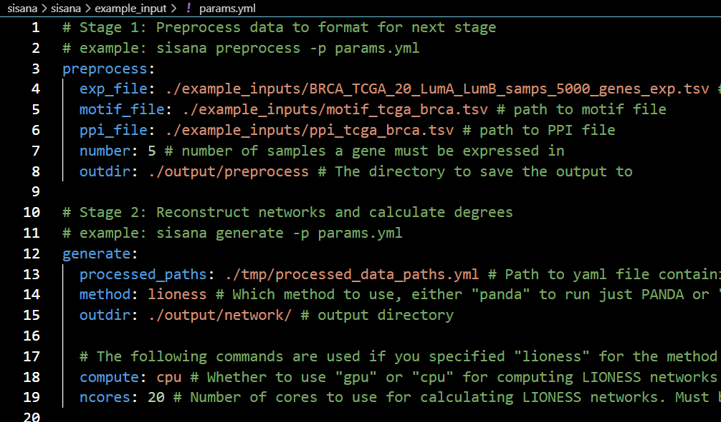
Running the sisana pipeline
./example_inputs/params.yml

Slide 32
Interpreting the results of sisana
So just to review:
Edge: The measure of the extent of regulation of a transcription factor on a single gene
TFs
genes
Out-degree: the sum of edge weights for a transcription factor
Tell you how much a single TF is regulating in general
A high out-degree means a TF is regulating many genes
High out-degree
Low out-degree
High in-degree
In-degree: the sum of edge weights for a gene
Tells you how much a single gene is being regulated in general
A high in-degree means it is being regulated to a great extent by TFs
Low in-degree
How “strongly” each TF regulates each gene

Slide 33
Instructions
Install SiSaNA using the instructions on the GitHub page (github.com/kuijjerlab/sisana/)
Work through the example steps on the SiSaNA GitHub README file (not the OBiWoW repository)
Please answer the questions on the SiSaNA GitHub repo in the docs/questions.md file. Make sure to use the terminal commands we give as hints!
We will discuss the answers at the end, but please ask us for help if you have any questions along the way!

Slide 34
A quick command line refresher
List all files: ls -al
Change directory: cd
Get your current location: pwd
Go back to previous command: Up arrow
Text editors: nano (recommended for beginners), vim, and emacs
Get number of lines in a file: wc –l
Extract single column from a file: awk '{print $N}' filename (where N is the column number)
View first lines of file: head filename
View contents of file (not in a text editor): cat filename
Get the unique lines in a file: uniq

Slide 35
Answers to worksheet questions
1. What is the structure of each of the three input files for SiSaNA's preprocessing step? What do the columns represent in each of the files?
Answer: Use head <file_name> to view the head of the file. In the params.yml file it explains the following:
- motif_file: ./input/motif_tcga_brca.tsv # path to motif file, where the first two columns are the TF and gene (motif) respectively, and the third column is a binary value indicating if the TF regulates that gene
- ppi_file: ./input/ppi_tcga_brca.tsv # path to PPI file, where the first two columns are TFs, and the third column is a binary value indicating if there is a known interaction between those TFs

Slide 36
Answers to worksheet questions
2. How many unique TFs are in the prior motif file? How many unique genes?
Answer:
awk '{print $1}' motif_prior_names_2024.tsv | sort | uniq | wc –l
646
awk '{print $2}' motif_prior_names_2024.tsv | sort | uniq | wc –l
61434

Slide 37
Answers to worksheet questions
3. After running the generate step, a few files are automatically generated. Which of them might you use to determine which genes were being most highly regulated?
Answer: the lioness_indegree.csv file

Slide 38
Answers to worksheet questions
4. Following the comparison of the expression of the two Luminal breast cancer groups (the default setup in the params.yml file), take a look at the output .txt file. What are some of the most differentially expressed genes?
Answer: FAM83D, IFNGR1, DEPDC1B, POLQ, UBE2T, etc.

Slide 39
Answers to worksheet questions
5. Do the same comparison as before but for the indegrees this time.
Answer: MAVS, CRYBA1, GDI22, ERLIN1, GTPBP4, etc.

Slide 40
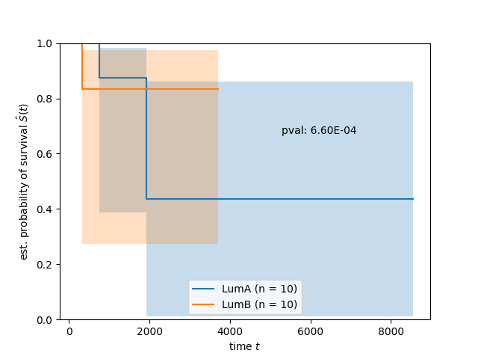
Answers to worksheet questions
6. Take a look at the output of the sisana visualize survival command. Do you know how to interpret this image? Additionally, there is a p-value listed there. Do you think we can conclude based on this p-value that there is a significant difference in the survival of Luminal A vs Luminal B patients?
Answer: It is a Kaplan-Meier curve. Points where the bars drop indicate patients have passed away due to disease (or possibly that no follow-up was made with their doctor at that time). The p-value in this case is misleading because we have so few patients in this analysis. Additionally, we have to consider that differences may just be there due to patients not going back to their doctors, not because they passed away at that time due to the disease.

Slide 41
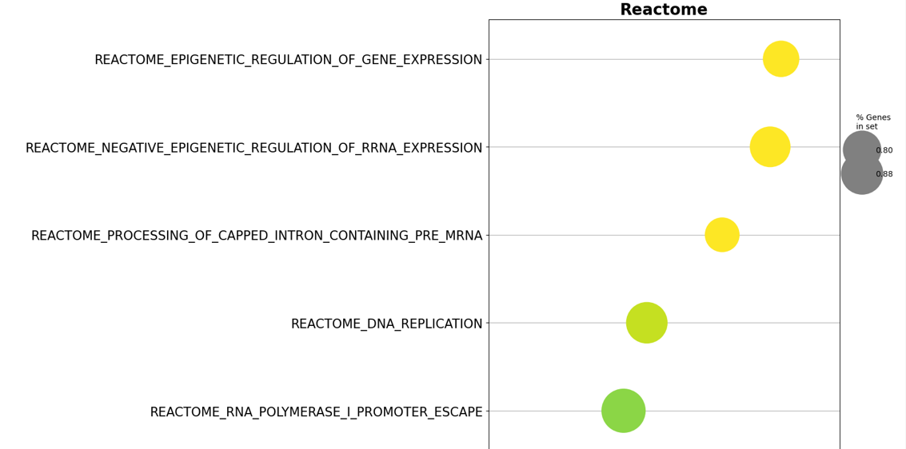
Answers to worksheet questions
7. Following running the sisana compare gsea step, what are the three top pathways? Run this step again, but with the Hallmark gene set instead of the Reactome one.
Answer: The three top pathways for Reactome are:
- Epigenetic regulation of gene expression
- Negative epigenetic regulation of rRNA expression
- Processing of capped intron containing pre-mRNA
And the top ones for Hallmark are:
- E2F targets
- Myc targets V2
- Pancreas beta cells

Slide 42
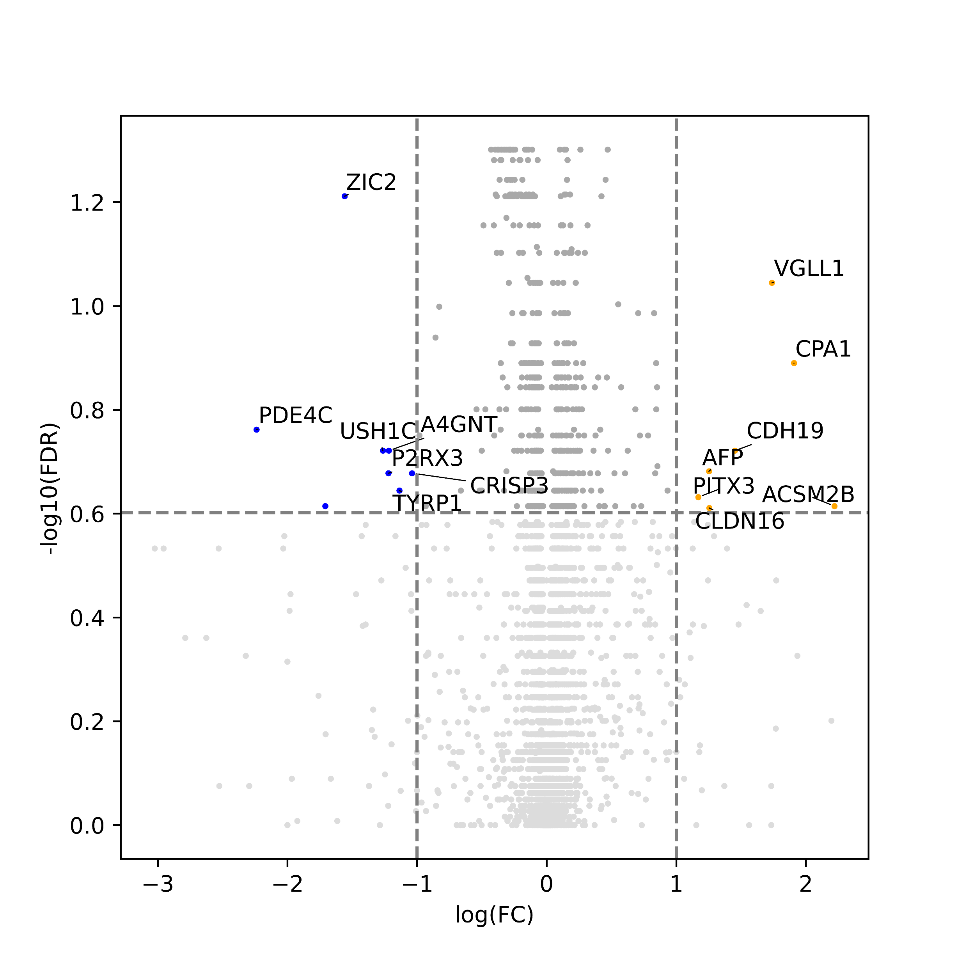
Answers to worksheet questions
8. Now let's look at the output of the sisana visualize volcano command. What do the dots on the left and right side of the plot represent? Do you recognize any of these genes?
Answer: Dots on the left side are those that are higher in LumB and those on the right are higher in LumA. I will add a legend to this figure in the future :)

Slide 43
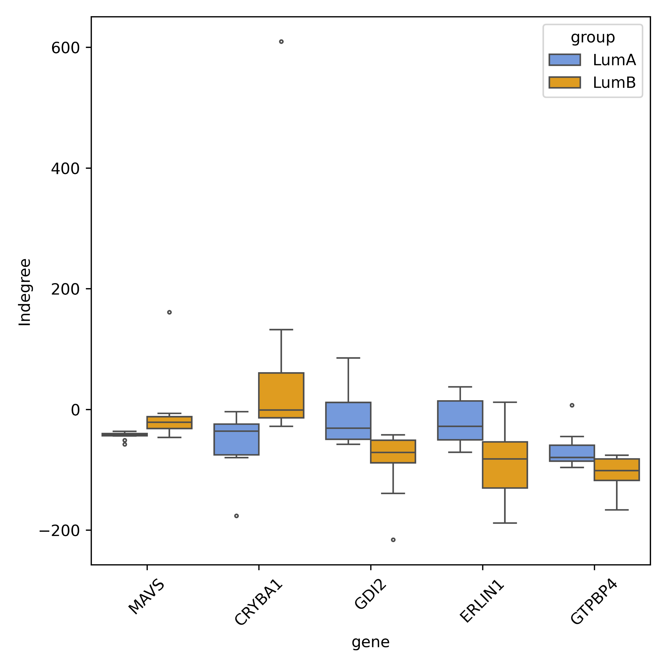
Answers to worksheet questions
9. Take 5 of the top differential indegrees (which you calculated in step 4) and make a box plot for those genes.

Slide 44
Answers to worksheet questions
10. How many TFs have edges that connect to (regulate) the GDI2 gene in your network? (Hint: Use the help function of SiSaNA (sisana -h) to find a subcommand that can help with this).
Answer: Use the "sisana extract" command and specify a file that has just the text "GDI2" written in it as the "namefile" parameter. Then, you can do wc -l <output_file> to count the number of rows. So the number of edges is the number of rows – 1, which is 188.

Slide 45

Course feedback
nolankn@uio.no

